Slide 1







Covid-19 Trends
Shubh Gaur
8-10-2021

Slide 2



OUTLINE
Executive Summary
Introduction
Methodology
Results
Visualization – Charts
Dashboard
Discussion
Conclusion

Slide 3

EXECUTIVE SUMMARY
Pfizer BioNTech – Comirnaty is most used vaccine.
Philippines use highest number of vaccines type.
India has Highest vaccinated population.
US has highest number of Cases and Deaths.
Vaccination reduce death rate.

Slide 4

INTRODUCTION
Analysis of Covid-19 trends.
Which Country has highest vaccinated population
Which Vaccine is preferer most.
Types of vaccine used by countries.
Highest vaccinated population in world.
This report help to understand covid-19 cases, deaths and vaccinations

Slide 5

METHODOLOGY
Dataset use csv file
Source of Database are WHO data
Correlation
Residential plot

Slide 6
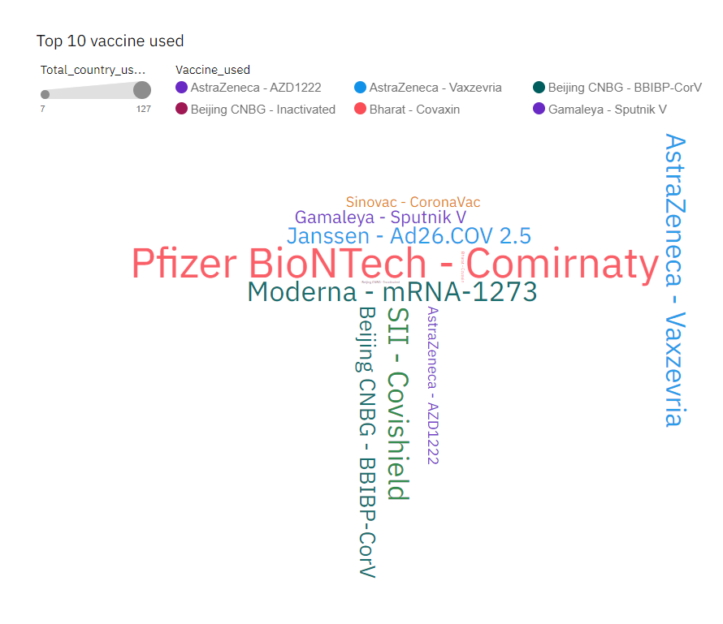
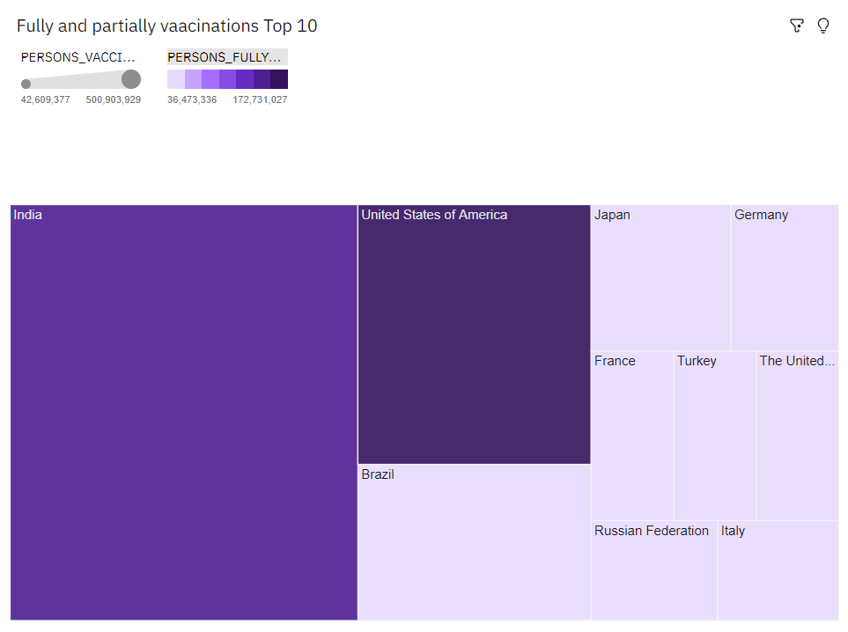
RESULTS

Slide 7
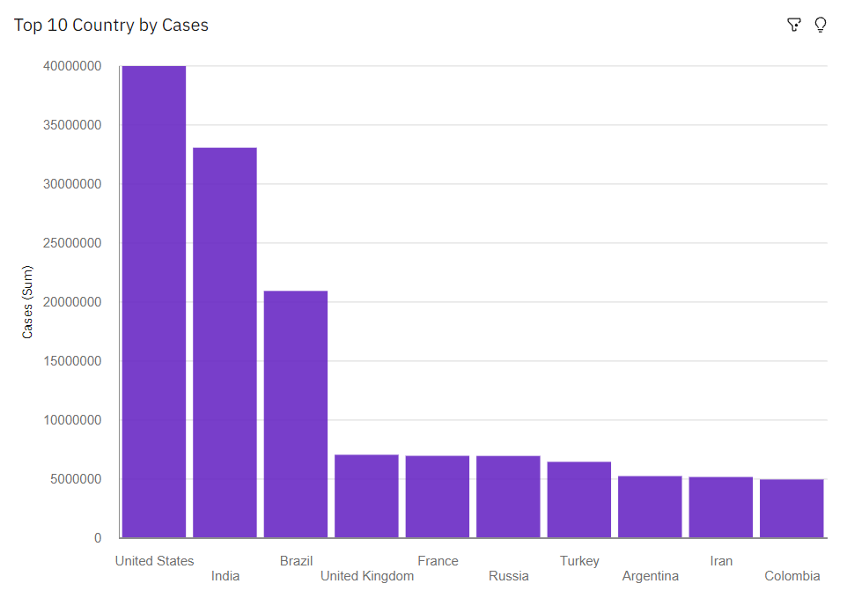
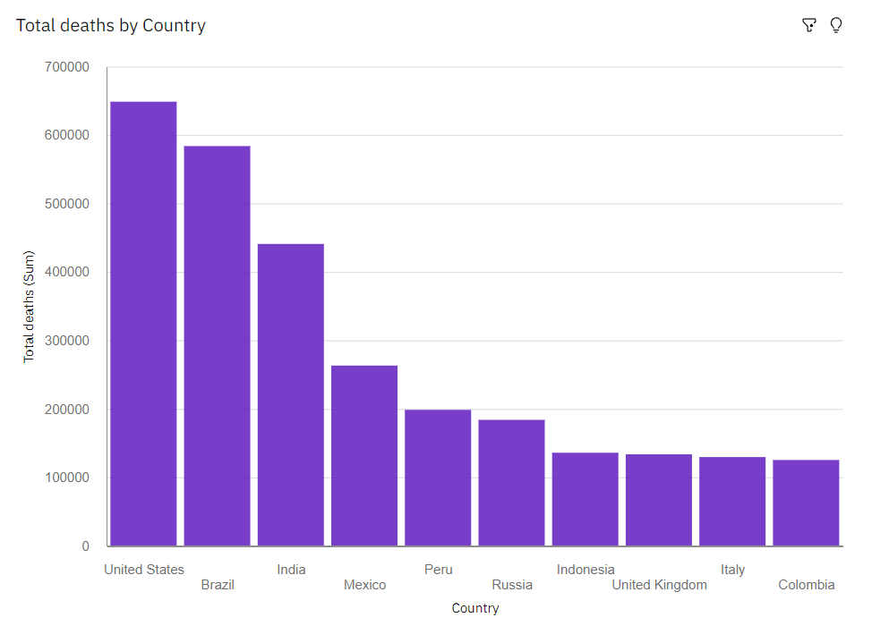
Top 10 covid-19 affected countries
Covid-19 Cases
Covid-19 Deaths

Slide 8
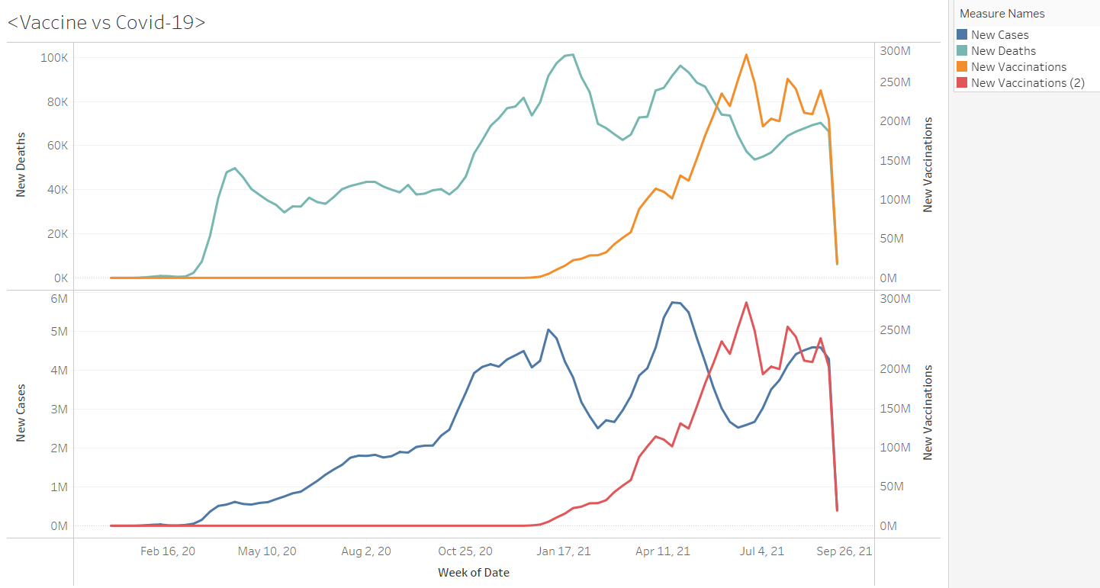
Covid-19 vs Vaccination

Slide 9
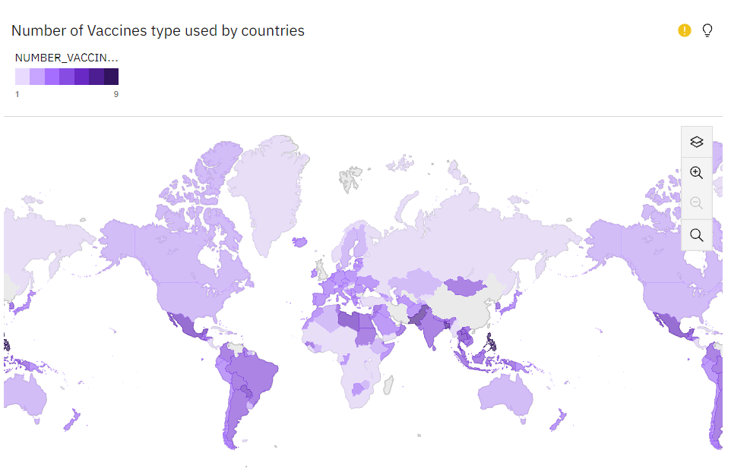
Covid-19 Vaccinations
Number of vaccines type used by countries
Top 10 vaccinated countries

Slide 10
PROGRAMMING LANGUAGE TRENDS - FINDINGS & IMPLICATIONS
Findings
US is highly affected by Covid-19
India has 2 highest cases but 3 highest deaths.
Highest covid case reported in April.
Philippines is using 9 types of vaccines.
India has highest vaccinated population but ratio is still less than other nations.
Implications
Higher vaccination rate reduce the risk of covid wave.
Vaccination can create Hard immunity against covid-19.
Due covid-19 economy break down higher then previous years
Vaccination drop 20-30% covid-19 cases.

Slide 11

DASHBOARD
https://us1.ca.analytics.ibm.com/bi/?perspective=dashboard&pathRef=.my_folders%2Fportfolio&action=view&mode=dashboard&subView=model0000017c384920a7_00000002

Slide 12
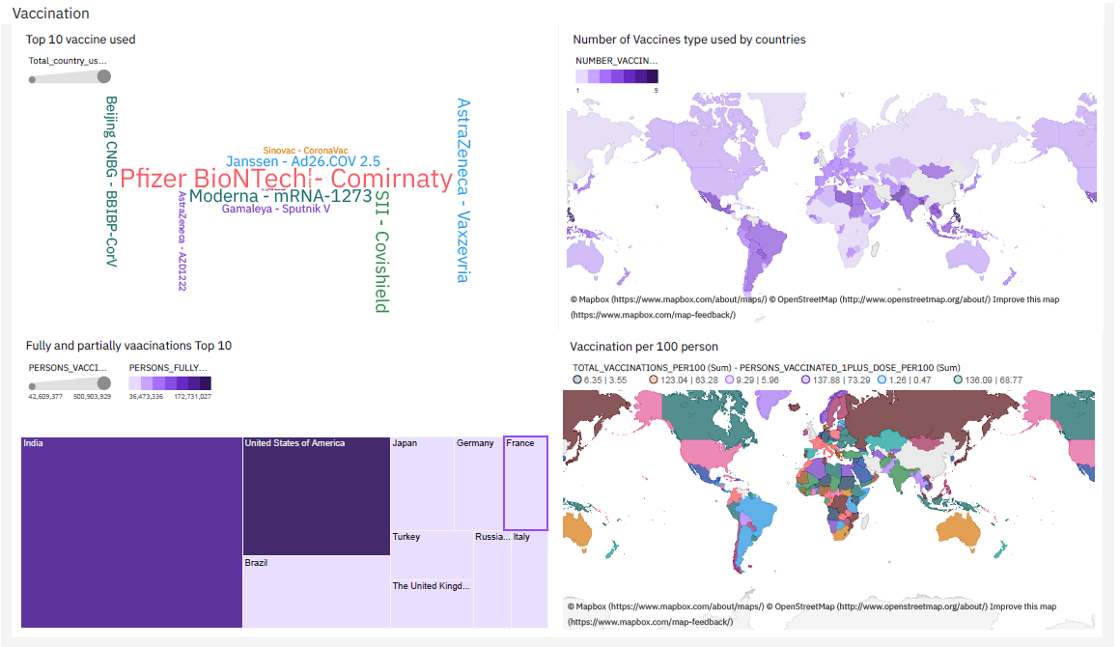
DASHBOARD TAB 1

Slide 13
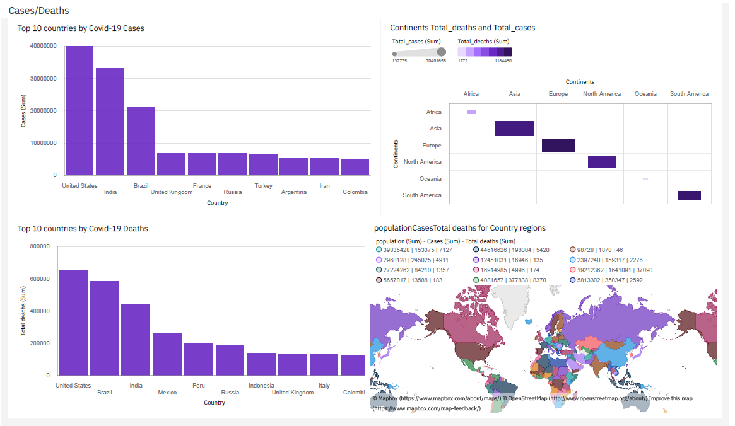
DASHBOARD TAB 2

Slide 14
DISCUSSION
One type vaccine which sufficient for everyone.
Which type of vaccine is preferred by developed and developing nations.

Slide 15

CONCLUSION
Developed nation prefer Pfizer BioNTech – Comirnaty vaccine.
Vaccination reduce the case’s around 20-30%.
Developing nation preferred various vaccines.
Asia is highly affected by covid-19.

